Slide 1
Computer Organization
Part 06: Interconnection Structures

Slide 2
Computer System
Hardware
Software
Data
Users

Slide 3
Interconnection Structures
A computer consists of a set of components (CPU,memory,I/O) that communicate with each other.
The collection of paths connecting the various modules is call the interconnection structure.
The design of this structure will depend on the exchange that must be made between modules.

Slide 4

Computer
Modules

Slide 5
Type of transfers
Memory to CPU
CPU to Memory
I/O to CPU
CPU to I/O
I/O to or from Memory (DMA)

Slide 6
Bus Interconnection
A bus is a communication pathway connecting two or more device.
A key characteristic of a bus is that it is a shared transmission medium.
A bus consists of multiple pathways or lines.
Each line is capable of transmitting signal representing binary digit (1 or 0)

Slide 7
Bus Interconnection
A sequence of bits can be transmit across a single line.
Several lines can be used to transmit bits simultaneously (in parallel).
A bus that connects major components (CPU,Memory,I/O) is called System Bus.
The most common computer interconnection structures are based on the use of one or more system buses.

Slide 8
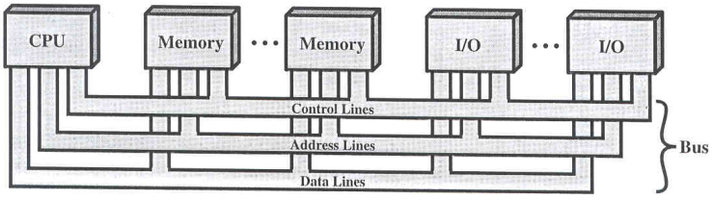
Bus Structure
A system bus consists of 50-100 lines.
Each line is assigned a particular meaning or function.
On any bus the lines can be classified into 3 groups
  Data lines
  Address lines
  Control lines

Slide 9
Data Lines
Provide a path for moving data between system modules.
These lines, collectively, are called the data bus
The data bus typically consists of 8,16 or 32 separate lines, the numbers of lines being transferred to as the width of the data bus.
Each line carry only 1 bit at a time, the number of lines determines how many bits can transferred at a time - overall system performance.

Slide 10
The Address Lines
Used to designate the source or destination of the data on the data bus
The width of the address bus determines the maximum possible memory capacity of the system.

Slide 11
The Control Lines
Used to control the access to and the use of the data and address lines.
Typical control lines include
  Memory write
  Memory read
  I/O write
  I/O read
  Clock
  Reset
  Bus request
  Bus grant
  Interrupt request
  Interrupt ACK
  Transfer ACK

Slide 12
The operation of the bus
If one module wishes to send data
obtain the use of the bus
transfer data via the bus
If one module wishes to request data
obtain the use of the bus
transfer request to the other module over the control and address lines, then wait for that second module to send the data.

Slide 13
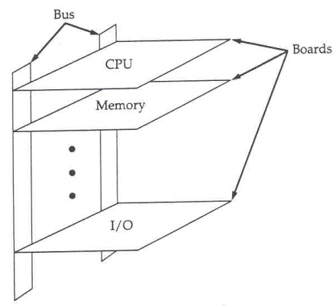
Physical Bus Architecture
System bus is a number of parallel electrical conductors.
The conductors are metal lines etched in a card or printed circuit board.
The bus extends across all of the components tat taps into the bus lines.

Slide 14

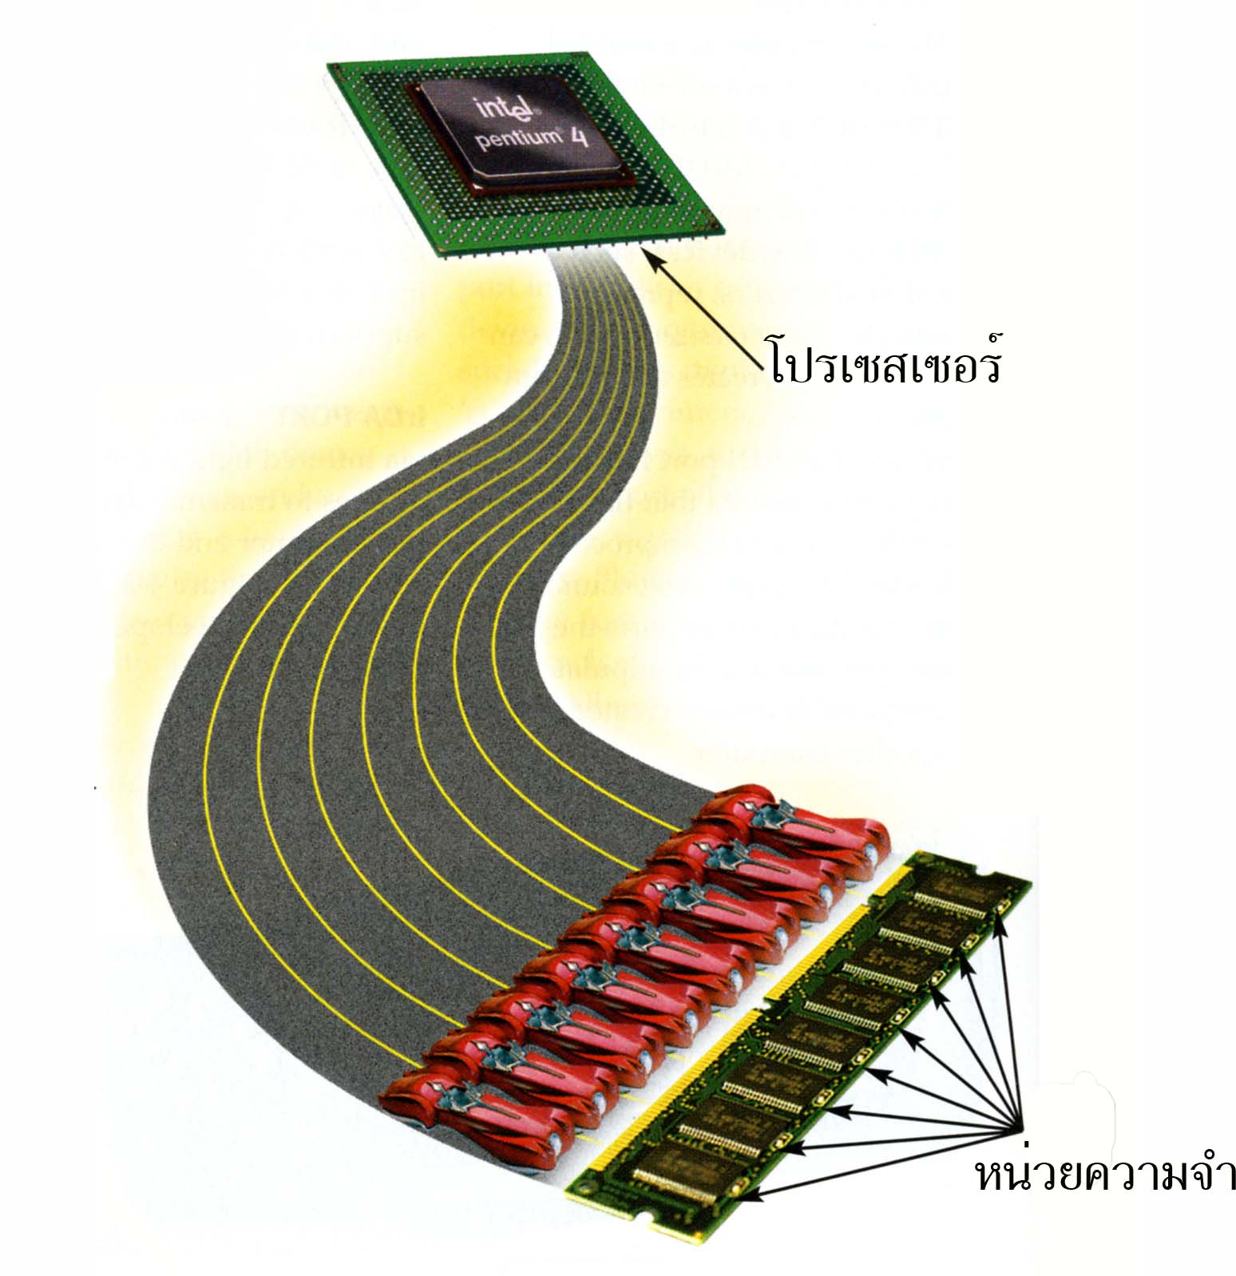
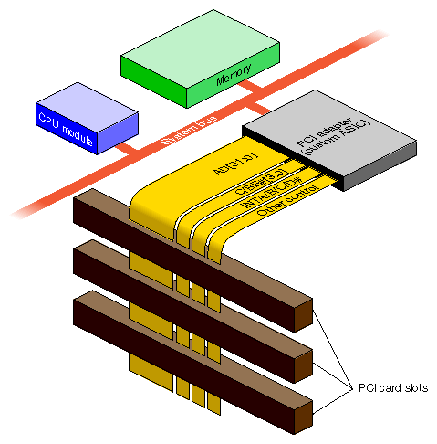
What do buses look like?

Slide 15
Multiple-Bus Hierarchies
More devices attached to bus, propagation delays affect performance
  How to arbitration?
Bottleneck as the aggregate data transfer demand approaches capacity of bus.
(e.g graphics & video controller)
  How to increase bus?

Slide 16
Traditional Bus Architecture
Local bus
  CPU - Cache
System bus
  Main memory - Cache
Expansion bus
  I/O Modules - Main memory

Slide 17
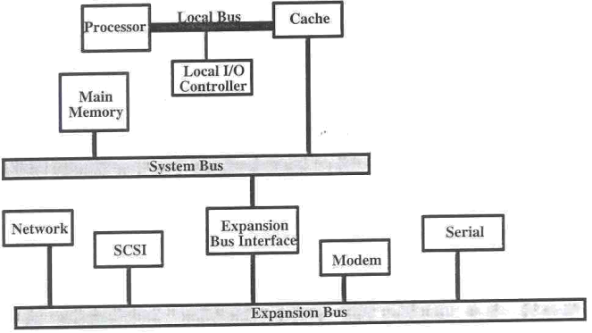
Traditional Bus Architecture

Slide 18
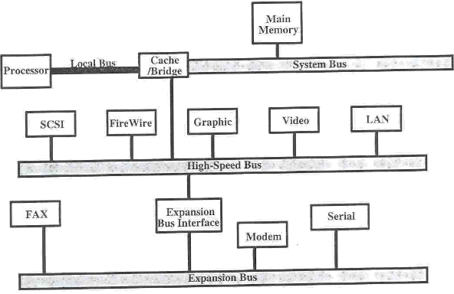
High-Performance Architecture
Local bus
  CPU - Cache/bridge
System bus
  Cache/bridge - memory
High-speed bus
  High-speed I/O module - Cache/bridge
Expansion bus
  Low-speed I/O modules - Expansion interface

Slide 19
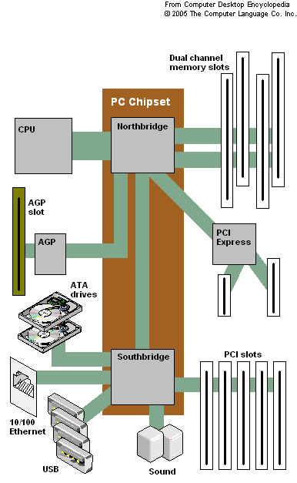
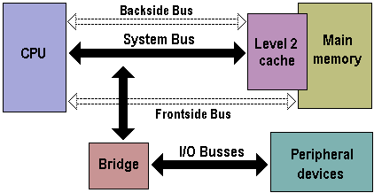

Slide 20
Bus Design
Type
  Dedicated
  Multiplexed
Bus Width
  Address
  Data
Timing
  Synchronous
  Asynchronous
Method of Arbitration
  Centralized
  Distributed
Data Transfer Type
  Read
  Write
  Read-modify-write
  Read-after-write
  Block

Slide 21
Type
Dedicated permanent assigned bus either to one function or to a physical subset of computer components
Multiplexed
use in the same bus for multiple purpose (Time Multiplexing)

Slide 22
Bus Width
Address
The wider of address bus has an impact on range of locations that can be referenced
Data
The wider of data bus has an impact on the number of bits transferred at one time

Slide 23
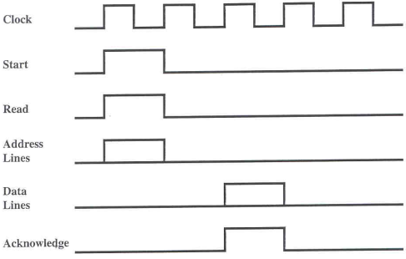
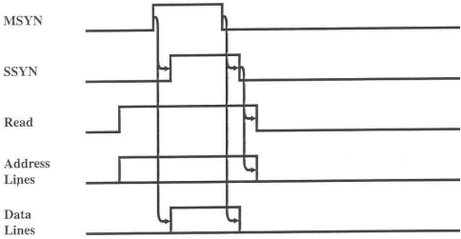
Timing
Synchronous occurrence of events on the bus is determined by a clock (Clock Cycle or Bus Cycle) which includes line upon
Asynchronous occurrence of one event follows and depends on the previous event.

Slide 24
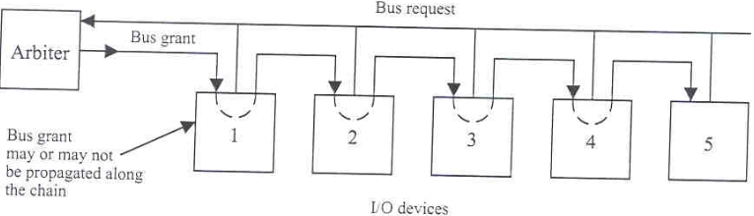
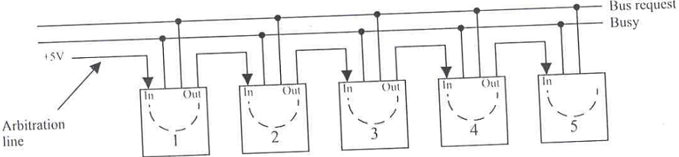
Method of Arbitration
Centralized bus controller (Arbiter), hardware device,is responsible for allocating time on the bus (daisy chain)
Distributed
access control logic in each module act together to share bus

Slide 25
Data Transfer Type
Read Multiplexed bus
is used to specifying address and then for transferring data after a wait while data is being fetched
Read Dedicated
address is put on bus and remain there while data are put on the data bus

Slide 26
Data Transfer Type
Write Multiplexed bus
is used to specifying address and then transferring data (same as read operation)
Write Dedicated
data put on data bus as soon as the address has stabilized

Slide 27
Data Transfer Type
Read-modify-write address is broadcast once at beginning a simply read is followed immediately by a write to the same address
Read-after-write a write followed immediately by a read from the same address,performed for checking purposes

Slide 28
Data Transfer Type
Block
one address cycle is followed by n data cycles. The first data item is transferred to or from the specified address; remainder data items are transferred to or from subsequent addresses

Slide 29
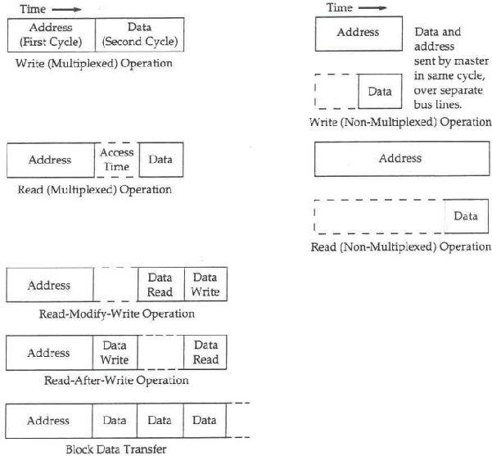
Data Transfer Type

Slide 30
Samples of Bus
ISA (Industry Standard Architecture)
MCA (Micro Channel Architecture)
EISA (Extended ISA)
VL Bus (VESA Local Bus)
PCI Bus (Peripheral Connection Interface)

Slide 31
Industry Standard Architecture
ISA is a standard bus (computer interconnection) architecture that is associated with the IBM AT motherboard.
It allows 16 bits at a time to flow between the motherboard circuitry and an expansion slot card and its associated device(s).

Slide 32
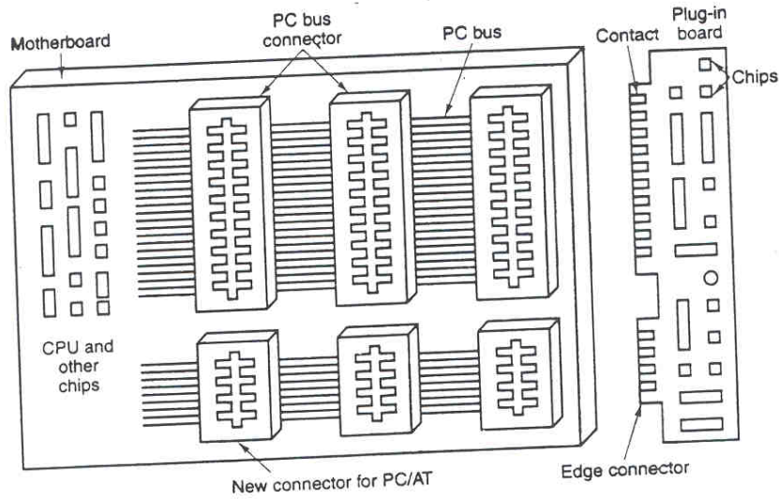
Industry Standard Architecture

Slide 33
Micro Channel Architecture
Developed by IBM for its line of PS/2 desktop computers, MCA is an interface between a computer (or multiple computers) and its expansion cards and their associated devices.
MCA was a distinct break from previous bus architectures such as ISA.
The pin connections in MCA are smaller than other bus interfaces. For this and other reasons, MCA does not support other bus architectures.

Slide 34
Micro Channel Architecture (cont.)
Although MCA offers a number of improvements over other bus architectures, its proprietary, nonstandard aspects did not encourage other manufacturers to adopt it.
It has influenced other bus designs and it is still in use in PS/2s and in some minicomputer systems.

Slide 35
Extended Industry Standard Architecture
EISA is a standard bus architecture that extends the ISA standard to a 32-bit interface. It was developed in part as an open alternative to the proprietary Micro Channel Architecture (MCA) that IBM introduced in its PS/2 computers.
EISA data transfer can reach a peak of 33 megabytes per second

Slide 36
VESA Local Bus
VESA VL bus is a standard interface between your computer and its expansion slot that provides faster data flow between the devices controlled by the expansion cards and your computer's microprocessor.
A "local bus" is a physical path on which data flows at almost the speed of the microprocessor, increasing total system performance.

Slide 37
VESA Local Bus (cont.)
VESA Local Bus is particularly effective in systems with advanced video cards and supports 32-bit data flow at 50 MHz
A VESA Local Bus is implemented by adding a supplemental slot and card that aligns with and augments an ISA expansion card. (ISA is the most common expansion slot in today's computers.)

Slide 38
Peripheral Component Interconnect
PCI is an interconnection system between a microprocessor and attached devices in which expansion slot are spaced closely for high speed operation.
Using PCI, a computer can support both new PCI cards while continuing to support ISA expansion cards, currently the most common kind of expansion card.

Slide 39
Peripheral Component Interconnect (cont.)
Designed by Intel, the original PCI was similar to the VESA Local Bus.
PCI2.0 is no longer a local bus and is designed to be independent of microprocessor design.
PCI is designed to be synchronized with the clock speed of the microprocessor, in the range of 33 to 66 MHz.
Standard : Up to 64 data-lines at 66 MHz. Raw transfer rate of 528 MBps or 4.224 Gbps.

Slide 40
Peripheral Component Interconnect (cont.)
PCI is now installed on most new desktop computers, not only those based on Intel's Pentium processor but also those based on the PowerPC.
PCI transmits 32 bits at a time in a 124-pin connection (the extra pins are for power supply and grounding) and 64 bits in a 188-pin connection in an expanded implementation.

Slide 41
Peripheral Component Interconnect (cont.)
PCI uses all active paths to transmit both address and data signals, sending the address on one clock cycle and data on the next.
PCI deliver better system performance for high-speed I/O subsystems
e.g. graphic display adapters, network interface controllers, disk controllers

Slide 42
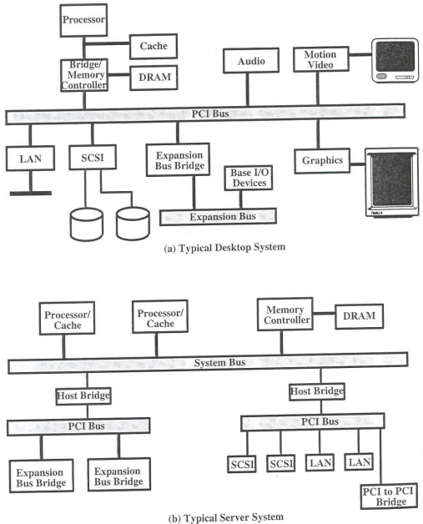
PCI
A Single-processor System
A Multiprocessor System

Slide 43
Interface
Port
Serial
Parallel
PS/2
PCMCIA
USB
(Universal Serial Bus)
No port
Infrared
Bluetooth

Slide 44
Universal Serial Bus
Standard bus which is invented by a group of companies : Compaq, DEC, IBM, Intel, Microsoft, NEC, Northern Telecom, etc.
Not change switch, jumper on board or other devices
Can use the same cable
Device that use USB can use power supply from PC.
Up to 127 devices connected off single port
Support real-time system
Hot Plug-in
Low cost

Slide 45
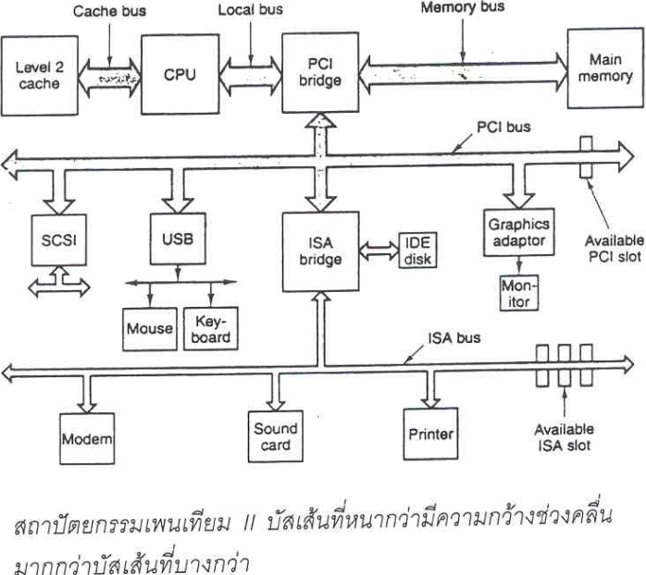
Multi-System Buses

